Slide 1
Data Science Engineering Methods and Tools Lecture 2
Northeastern University
College of Engineering
INFO 6105 – Spring 2024
Abdolreza Mosaddegh

Slide 2
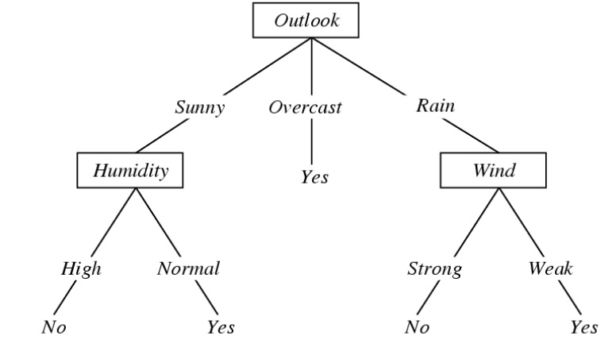
Decision Tree
A decision tree is a hierarchical classification model that uses a tree structure and can be used to support decisions
Each internal node represent a test on one attribute (feature)
Each branch from a node represents a possible outcome of the test
Each leaf node represents a class label
Is weather condition suitable for playing tennis?

Slide 3
Decision Tree - Supervised Learning
Columns denote features
Rows denote labeled instances
Class label denotes whether a tennis game was played
Prediction: Rainy and Strong Wind > Play Tennis or Not?

Slide 4
Decision Tree as a Non-linear Classifier
Decision trees divide the feature space into axis-parallel rectangles

Slide 5
Splitting Categorical Variables in D-Tree
Multi-way split:
Use as many partitions as distinct values.
Binary split:
Divides values into two subsets
Need to find optimal partitioning.
Preserve order property among attribute values
By considering performance issues, most common algorithms prefer binary split since there are too many possibilities for the next split in the multiway D-Trees

Slide 6
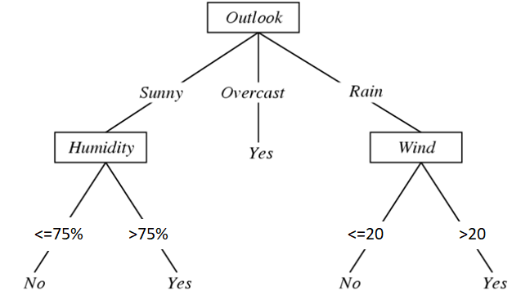
Discretizing Continuous Variables in D-Tree
If features are continuous, internal nodes can test the value of a feature against a threshold.
Heuristic approaches can be used for finding optimal thresholds.

Slide 7
Making a Random D-Tree from Data

Slide 8
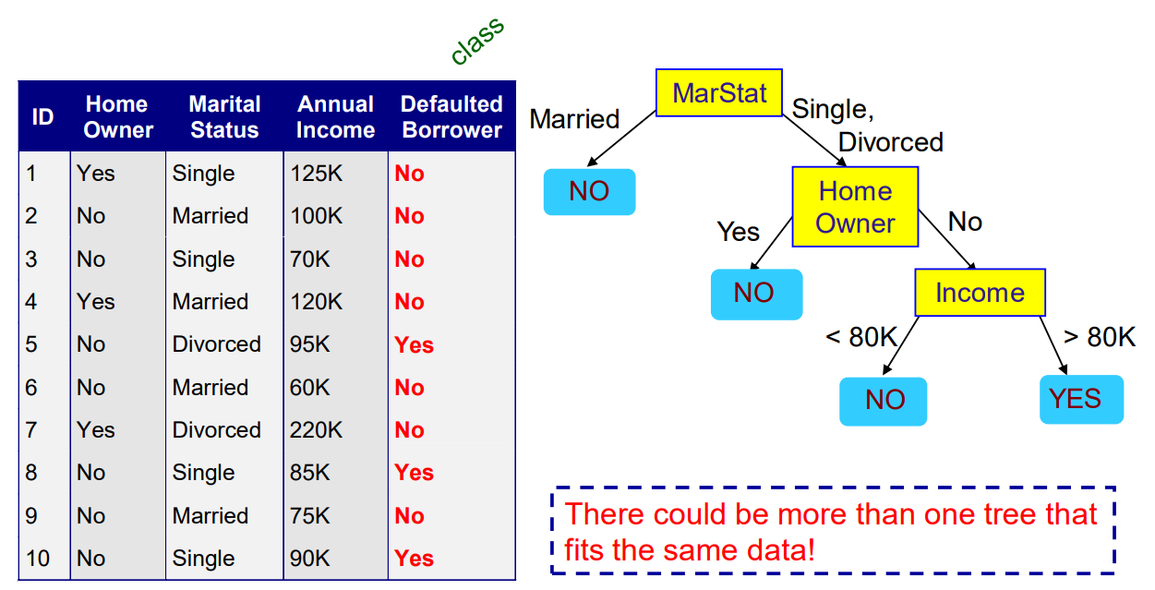
Another D-Tree with the Same Data
Which D-Tree is better?

Slide 9
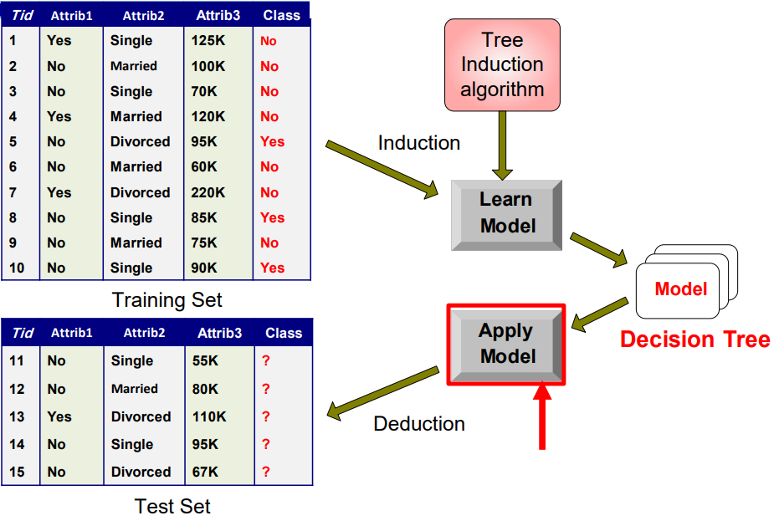

Slide 10
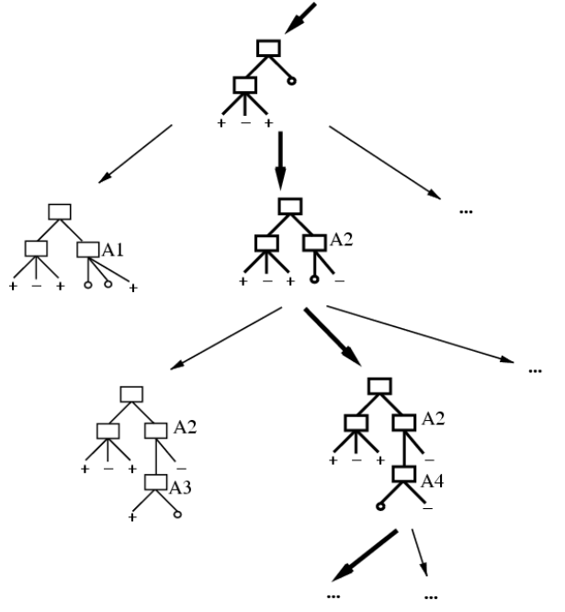
Problem Statement: Which Tree?
Occam’s razor:
In philosophy, Occam's razor is a problem-solving principle that recommends searching for explanations constructed with the smallest possible set of elements.
Occam's razor has gained strong empirical support in statistics and machine learning.
Based on Occam’s razor principle, the smallest decision tree that correctly classifies training examples is the best.

Slide 11
Smallest Tree
Learning the simplest (smallest) decision tree is an NP-complete problem [Hyafil & Rivest ’76]
• Resort to a greedy heuristic:
- Start from empty decision tree
- Split on next best attribute (feature)
- Recurse
Greedy algorithms make a locally optimal choice at each stage that approximate a globally optimal solution in a reasonable amount of time.
Sometimes, a greedy strategy does not produce an optimal solution, but just can yield locally optimal outcomes.

Slide 12
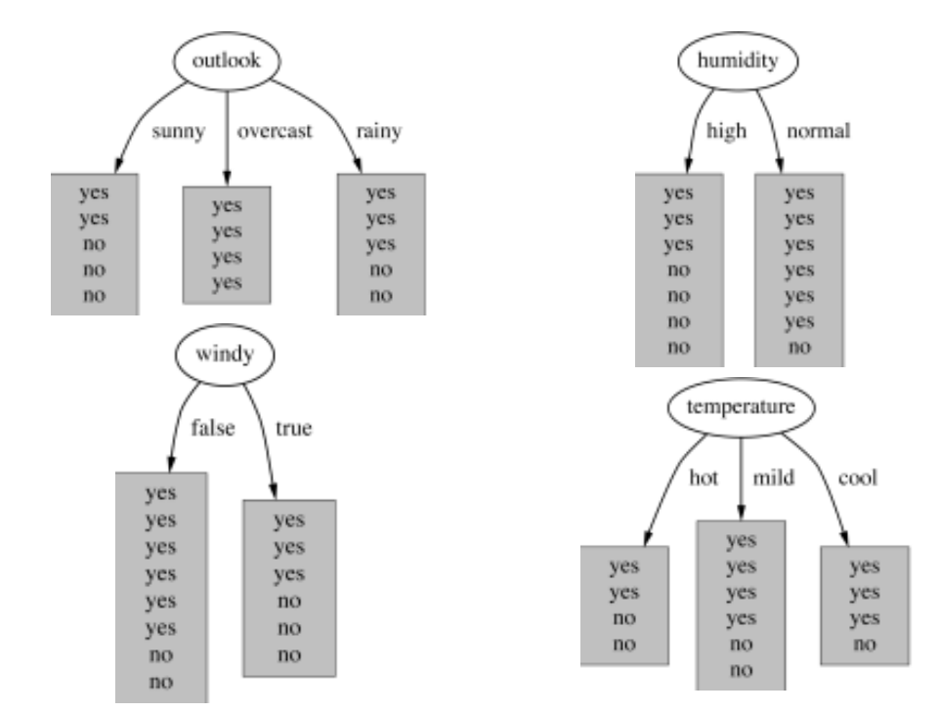
Which Attribute is the Best?
Heuristic:
choose the attribute that produces best classification (the “purest” nodes)

Slide 13
Impurity as Loss Function
Impurity is presence of more than one class in a subset of data
Impurity measures are used in Decision Trees as a loss function.
Learning process tries to find lowest impurity as possible

Slide 14
Gain
Which spilt decreases impurity more?
Gain = Impurity before spilt – Impurity after spilt
Bigger gain indicates more decrease in impurity after split

Slide 15
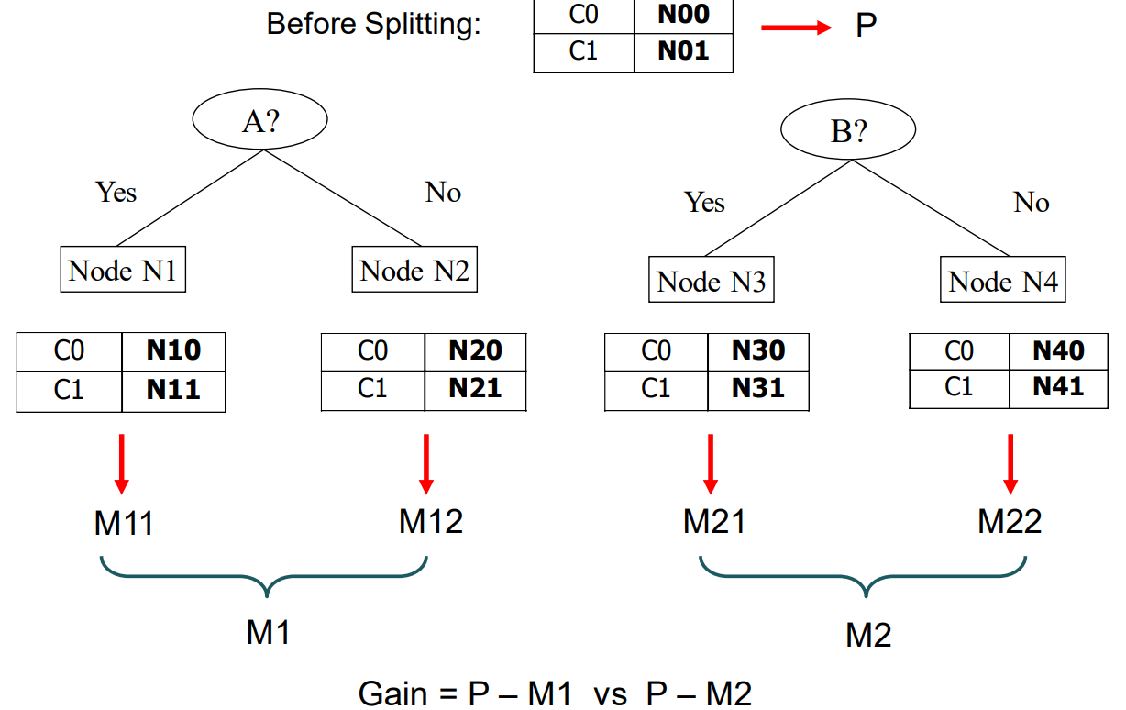
Splitting by Gain
1- Compute impurity measure (P) before splitting
2- Compute impurity measure (M) after splitting by any attribute
Compute impurity measure of each child node
Compute the average impurity of the children
3- Calculate gain as follows:
Gain = P – M
4- Choose the attribute test condition that produces the highest gain
This method needs a measure of impurity

Slide 16
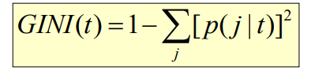
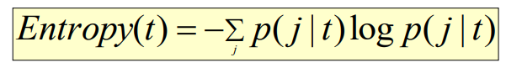
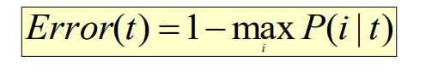
Impurity Measures
For a given node t (p( j | t) is the relative frequency of class j at node t)
• Gini Index
• Entropy
• Misclassification error

Slide 17
Gini Index
Gini Index for a given node t :
p( j | t) is the relative frequency of class j at node t
The Gini coefficient measures the inequality among the values of a frequency distribution
– Maximum (1 - 1/Number_of_classes ) when records are equally distributed among all classes, implying least interesting information
– Minimum (0) when all records belong to one class, implying most interesting information
When a node p is split into k partitions :

Slide 18
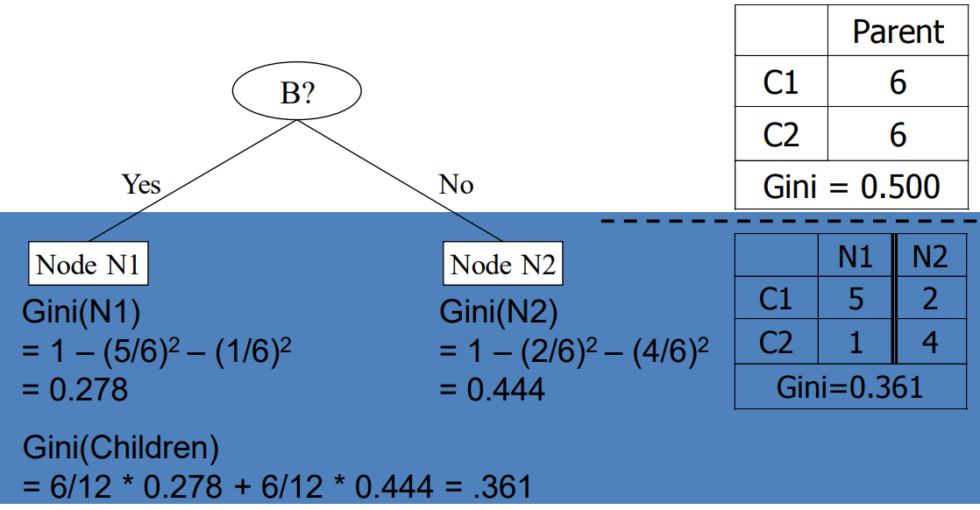
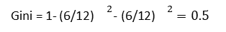
Selection using Information Gain
Play Tennis
Not Play Tennis
Gini = 1- (6/12)${}^{2}\text{− }\text{(6/12)}{}^{2}=0.5$
Gain = 0.500 – 0.361 = 0.139

Slide 19
Classification Error
Classification error at a node t:
Measures misclassification error made by a node.
– Maximum (1 - 1/Number_of_classes) when records are equally distributed among all classes, implying least interesting information
– Minimum (0) when all records belong to one class, implying most interesting information

Slide 20
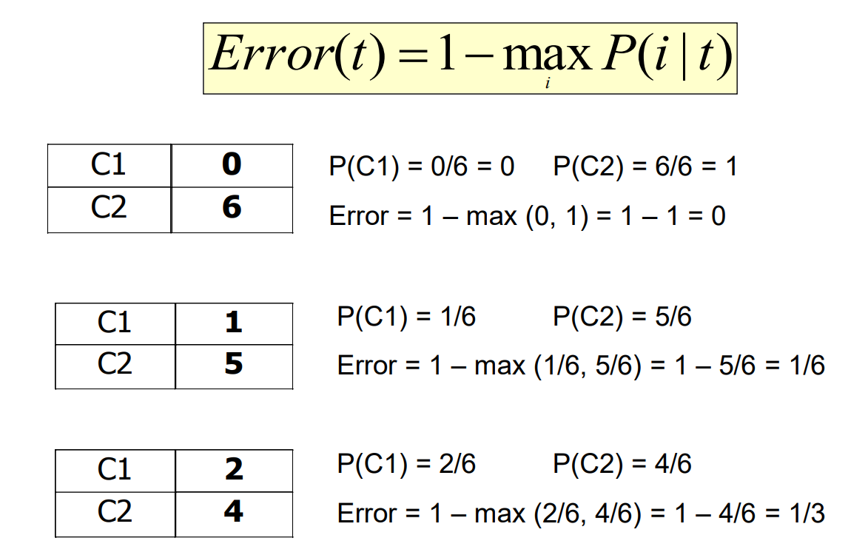

Slide 21
Entropy
Entropy at a given node t:
Entropy is commonly associated with a state of disorder or uncertainty
– Maximum (Log Number_of_classes ) when records are equally distributed among all classes implying least information
– Minimum (0.0) when all records belong to one class, implying most information
Entropy based computations are quite similar to the GINI index computations

Slide 23
Comparing Impurity Measures
Entropy and Gini are more sensitive to changes in the node probabilities than the misclassification error rate
For a 2-class problem

Slide 24
Information Gain
Information gain is the reduction in entropy produced from splitting.
Information Gain after splitting parent node(p) with n records:
ni is number of records in partition i
– Choose the split that achieves most reduction in Entropy(maximizes GAIN)
– Used in the ID3 decision tree algorithm

Slide 25
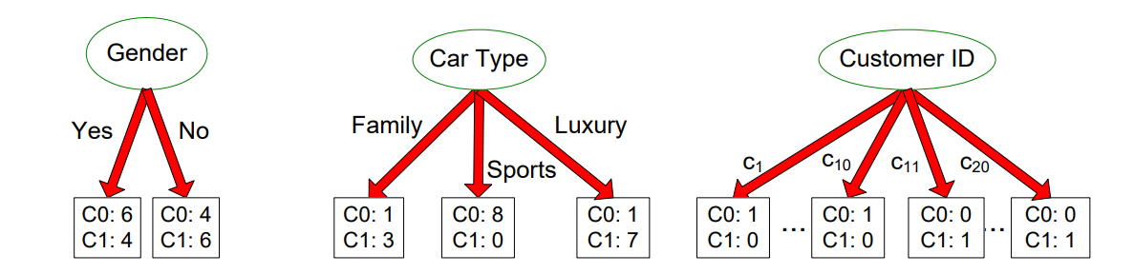
Disadvantage of information gain
• It prefers attributes with large number of values that split the data into small, pure subsets
• Quinlan’s gain ratio uses normalization to improve this
Customer ID has highest information gain because entropy for all the children is zero
information gain has the disadvantage that it prefers attributes with large number of values that split the data into small, pure subsets leads to overfitting to train dataset.

Slide 26
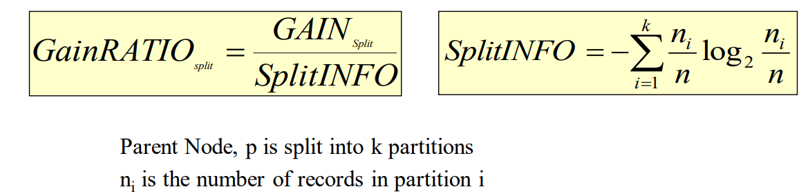
Gain Ratio (Quinlan’s Gain Ratio)
Adjusts Information Gain by the entropy of the partitioning (SplitINFO).
Large number of small partitions is penalized
Designed to overcome the disadvantage of Information Gain
Used in C4.5 algorithm

Slide 27
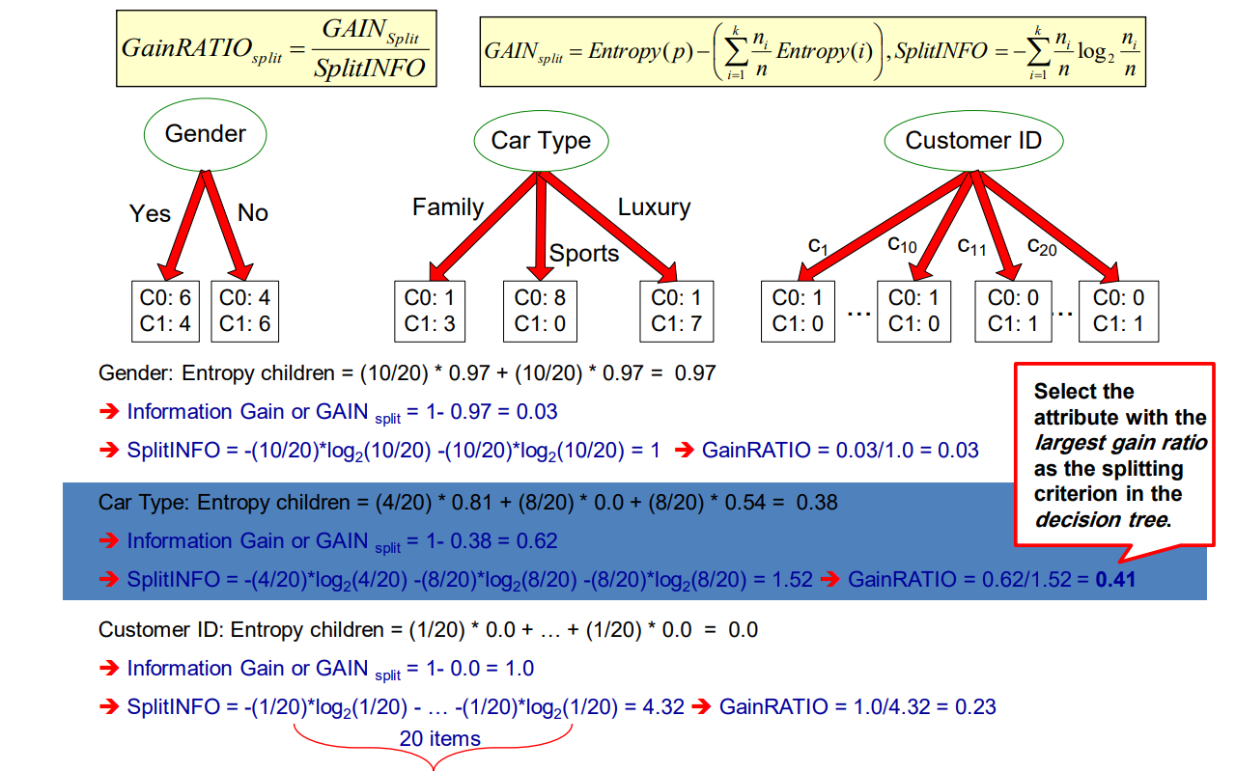

Slide 28
Stop splitting
How should the splitting procedure stop?
If all the records belong to a same class in all nodes
If all the records in any node have identical attribute values
Early termination of process by settings some limits
Growth of a decision tree leads to complexity of the model and overfitting to training data

Slide 29
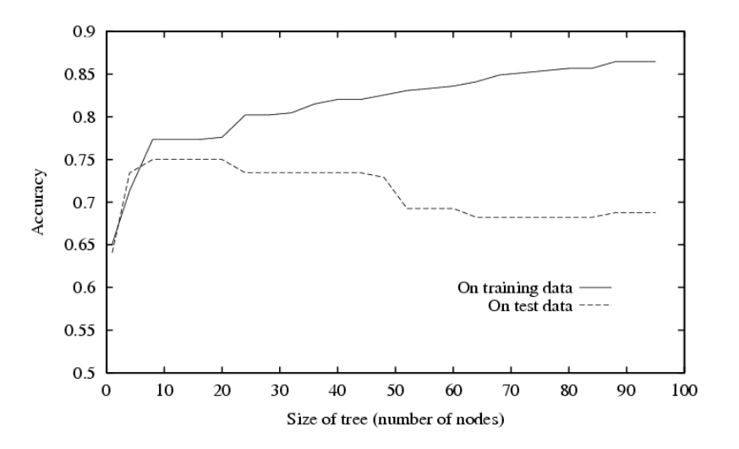
Avoid overfitting
Two main approaches:
Reduce model complexity by stopping growth of the tree using constraints (during creation of tree)
Grow full tree, then prune to reduce model complexity
Performance of the tree degrades by adding complexity after 20 nodes

Slide 30
Stop Growth (Pre-pruning) techniques
Pre pruning stops the growth of decision tree on an early stage (to avoid complexity of model).
Complexity of a ML model make it perfect for training data but limits the generalizability of the model thus the performance degrades on test / production phase.
We can limit the growth of trees by setting constraints with optimum values using a heuristic approach.
The validation data can be used to select best constraints (Hyper-parameters).
A hyperparameter is a parameter which specifies details of the learning process, in contrast to parameters which determine the model itself.
Some of hyperparameters can be used as a constraint in decision trees are as follows:
max_depth: maximum depth of decision tree
min_sample_split: The minimum number of samples required to split an internal node:
min_samples_leaf: The minimum number of samples required to be at a leaf node
min_impurity_decrease: The minimum decrease in impurity by spliting

Slide 31
Example of Hyper-parameters

Slide 32
Post pruning techniques
Cost complexity pruning (CCP) provides an option to control the size of a tree by pruning after creating the tree.
This pruning technique adds complexity penalty to impurity.
It is parameterized by the cost complexity parameter, ccp_alpha.
Greater values of ccp_alpha increase the number of nodes pruned.
When ccp_alpha is set to zero, the tree overfits.
As alpha increases, more of the tree is pruned, thus creating a decision tree that generalizes better.

Slide 33
Cost complexity pruning
Minimal cost complexity pruning recursively finds the node with the “weakest link”.
The weakest link is characterized by an effective alpha, where the nodes with the smallest effective alpha are pruned first.
Path of cost complexity pruning returns the effective alphas and the corresponding total leaf impurities at each step of the pruning process.
As alpha increases, more of the tree is pruned, which increases the total impurity of its leaves.

Slide 34
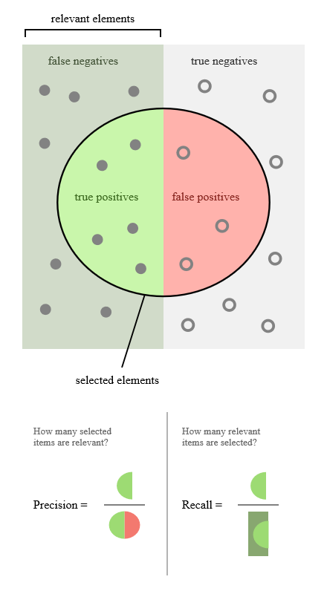
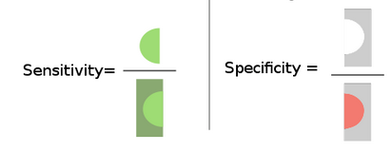
Model Assessment
Confusion Matrix

Slide 35
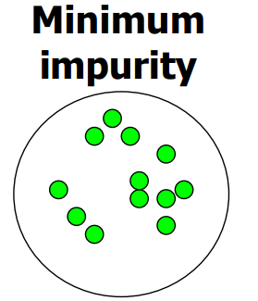
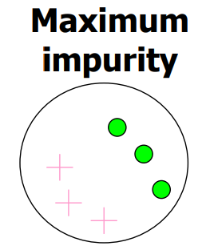
Preprocessing - Balancing Training Data
A dataset in which most of examples belong to a same class is not a good training set for learning (Low Impurity).
We need to balance such dataset using balancing techniques.

Slide 36
Right Assessment in Imbalanced Data
If there is a dataset with more than 90% percent of one class a model which classifies all samples into that class will have an excellent accuracy (more than 90%).
In such cases, Sensitivity (Recall) and Specificity measures should be calculated besides accuracy rate.
It is also possible to design a loss function that is penalizing wrong classification of the rare class more than wrong classifications of the abundant class.

Slide 37
Resampling from Imbalanced Data
Under-sampling:
Balances the dataset by reducing the size of large classes.
This method is used when large quantity of data is available for training
Over-sampling:
Balance dataset by increasing the size of rare classes.
Oversampling is used when the size of training data is limited.
New samples are generated using repetition, bootstrapping or SMOTE

Slide 38
Preprocessing - Normalizing Data
Loss function in Decision Tree is impurity
Despite many ML models this loss function (impurity) is not affected by distance between feature values, therefore, normalizing features (scaling) has no impact on performance of the model.
In white-box models (e.g., Decision Tree), not just prediction but interpretability of results is important, especially if the model is used in a semi-automated decision-making process.
2,3 -> Normalizing features is not recommended since it has no effect on performance but makes results less interpretable.

Slide 39
Dealing with missing values in D-tree
All missing values assigned to a node with the biggest number of instances.
Missing values are distributed to all children proportional with the number of instances from each child node.
Missing values are distributed randomly to only one single child node.
Missing values can be handled during data pre-processing phase.

Slide 40
Convert Decision trees to IF-THEN rules

Slide 41
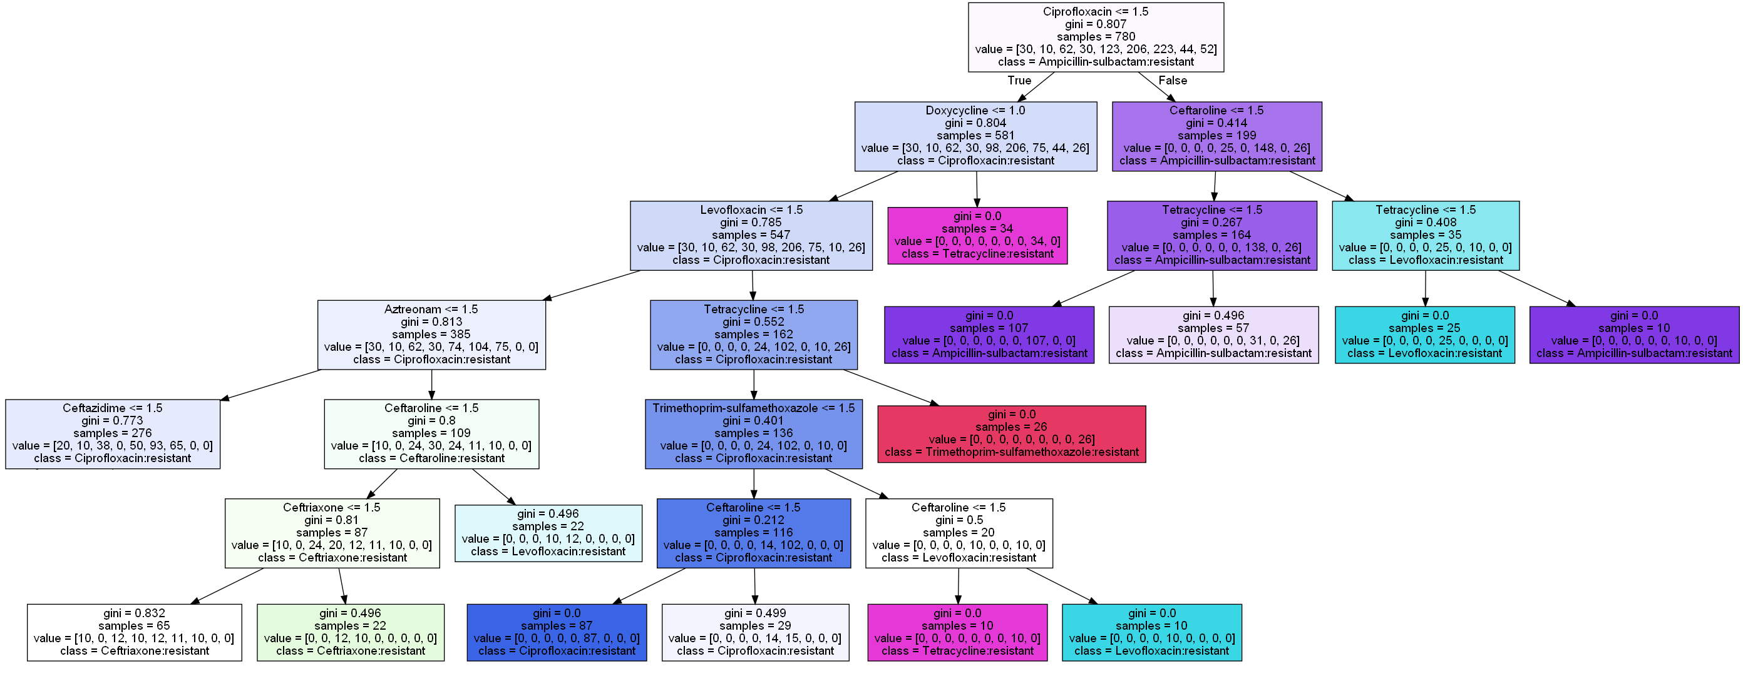
Application of Decision Tree
1-> Susceptible
2-> Intermediate
3-> Resistant

Slide 42
Application of Decision Tree

Slide 43
Most Common D-Tree Algorithms
CART: Classification And Regression Tree is a non-incremental decision tree inducer for both classification and regression problems.
ID3, C5: A “decision tree induction algorithm”, developed by Ross Quinlan (1979). ID3 stands for "Iterative Dichotomiser (version) 3". Later versions include C4 (1987), C4.5 (1993), and C5.
SLIQ: Supervised Learning In Ques uses a fast sub-setting algorithm for determining splits for categorical attributes.
SPRINT: Scalable PaRallelizable INndution of decision Trees is a scalable parallel classifier for data mining.
VFDT: Very Fast Decision Trees learner reduces training time for large incremental data sets by subsampling the incoming data stream.
EFDT : Extremely Fast Decision Tree learner is statistically more powerful than VFDT, allowing it to learn more detailed trees from less data.

Slide 44
D-Tree Advantages
Handle non-Linear classification
Interpretability of results
Transparency in producing results (White-box model)
Accuracy is reasonable for most uncomplex problems
Model transparency supports semi-automated decision making suitable for many applications
Decision trees are able to generate understandable rules.

Slide 45
D-Tree Disadvantages
Accuracy is less than some advanced ML techniques (e.g., DNNs) for some complex classification / prediction problems
Decision trees are prone to errors in classification problems with small number of training examples.
The processes of growing and pruning of decisions tree are computationally expensive
The Decision trees are prone to overfitting problem.
A small change in the training data can lead to a completely different tree structure, making decision trees unstable

Slide 46
Assignment 2
Clean the dataset used in the first assignment in a way that is suitable for decision trees.
Create a binary decision tree using Gini index impurity measure over the cleaned data to predict Resistance (as the label) by Patient_Age, Bacteria, and Antimicrobial (as features).
Consider the following ranges of values for hyper-parameters:
max_depth = [3, 5, 10, 15]
min_sample_split= [5, 10, 30, 60]
min_samples_leaf= [3, 10, 20, 40]
min_impurity_decrease = [0.05, 0.01, 0.001, 0.0005]
ccp_alpha = [0.01, 0.001, 0.0005, 0.0001]
Spilt data into train, test, and validation (72%, 20%, 8%) and use validation data to select best hyper-parameter.
Calculate accuracy , specificity , and sensitivity of the best Dtree on test data using confusion matrix
Extract three rules from the decision tree.

